Slide 1


Technical Test Data Analytics
Enrique Revuelta García

Slide 2

TABLE OF CONTENTS
01
Task Choosed
02
Match Analysis Example
03
Squad’s Analysis & Player’s Classification
04
Technical Test Anwers
Player’s Tactical Classification
Barcelona – Real Madrid 19/20
Initial Squads & Final Stats
Deep Analysis of each team
Player’s Tactical Classification
Anwers for the questions proposed

Slide 3


Task Choosed
Write a method thar assigns players on each team to a tactical unit:
Describe your general approach and any difficulties you encountered
Where does your approach work well and where does it break down?
How do you think it could be improved given more resources?
What are some applications of this model?

Slide 4
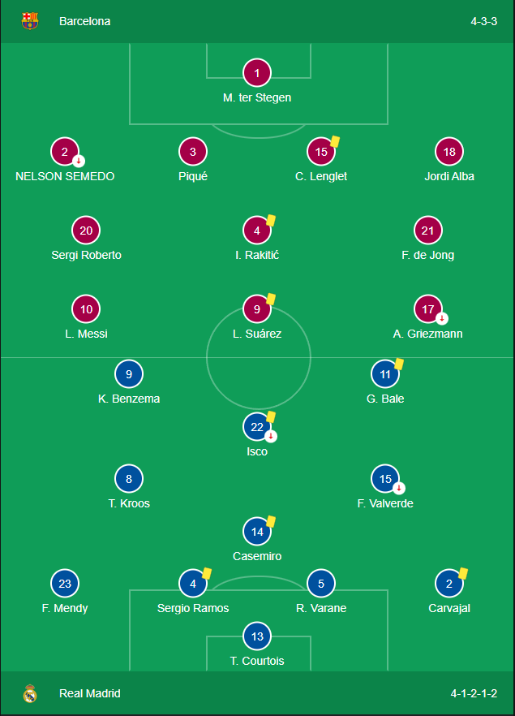
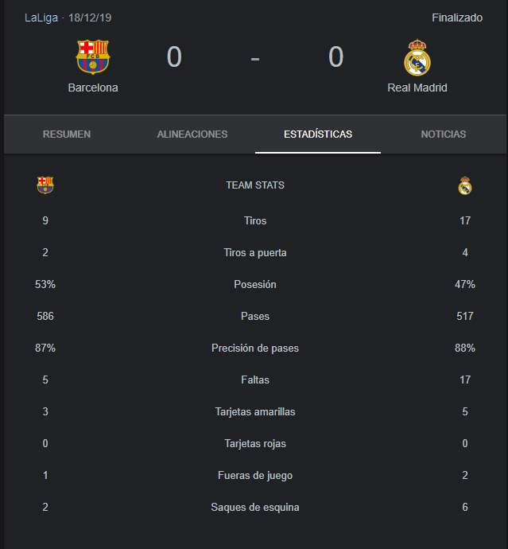
Match Analysis Example – Barcelona vs Real Madrid 19/20
Initial Squads
Final Stats

Slide 5
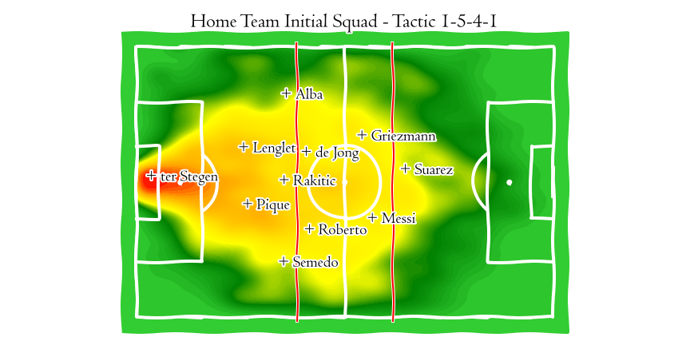
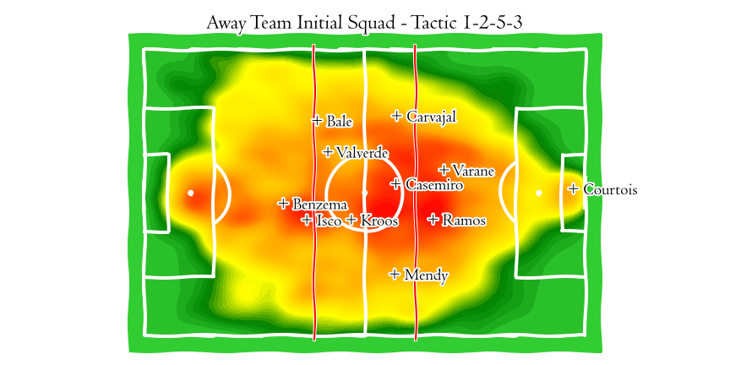
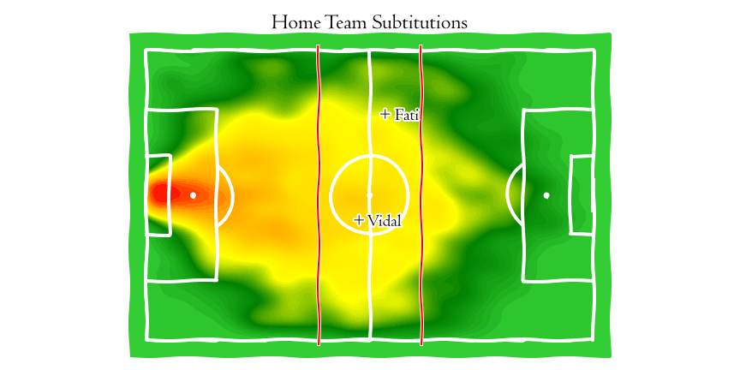
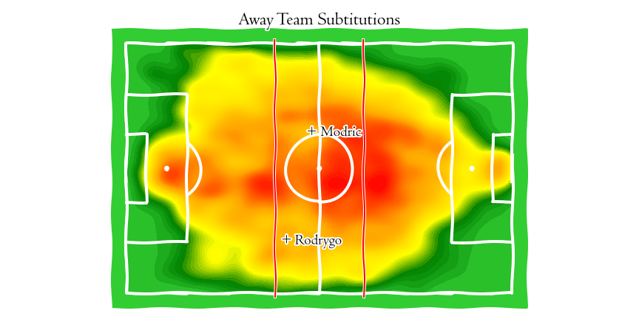
Squad´s Analysis & Player’s Tactical Classification

Slide 6
Technical Test Anwers
General approach & difficulties encountered:
How do you think the model will be improved:
Difficulties:
First time working with skillCorner Data
First time working with mlpsoccer library
General approach:
Explore the data
Apply my Python programming knowledge to extract the data from json files as clean as possible
Try to use my soccer knowledge to find the better position on x edge to create tactical’s lines clusters
With more historic data and a database with all the players as possible.
If we had and historic data about all players we can compare the various positions of each player on his career
This can help us to find the best candidate for the positions that our team need to be improved
Adding a video analysis to this model
Where does your approach work well and where does it break down?
Applications for the model
I think the model is working good for this match.
It resumes the data of the match at first view
If we want to classifficate players we need more data, it’s impossible make a player classification with only one match of each player
The model can help our coach to make a better tactic against the next rivals
The model can show our coach if the players follow the tactic that planed during the week
Can help to the scouts to find the bests candidates for the positions that our team will need improve

Slide 7



THANKS!
EN LEGANES LOS SUEÑOS SE CUMPLEN
Do you have any questions?
enrique.revuelta@enriquerevueltagarcia.com
+34 659 630 198
www.enriquerevueltagarcia.com

